Slide 1
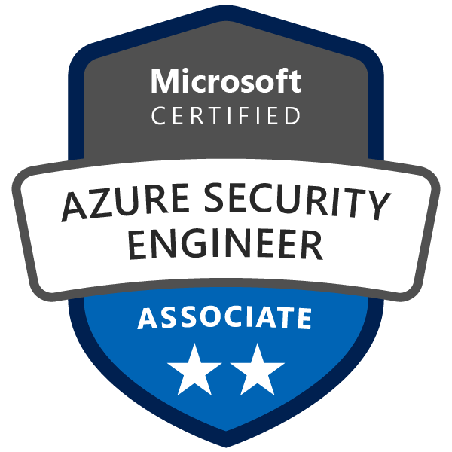
Exam AZ-500: Microsoft Azure Security Technologies Crash Course
Tim Warner

Slide 2
AAA Model
Authentication
Identity verification
Authorization
Access scope
Accounting
Successful and failed AuthN and AuthZ attempts

Slide 3
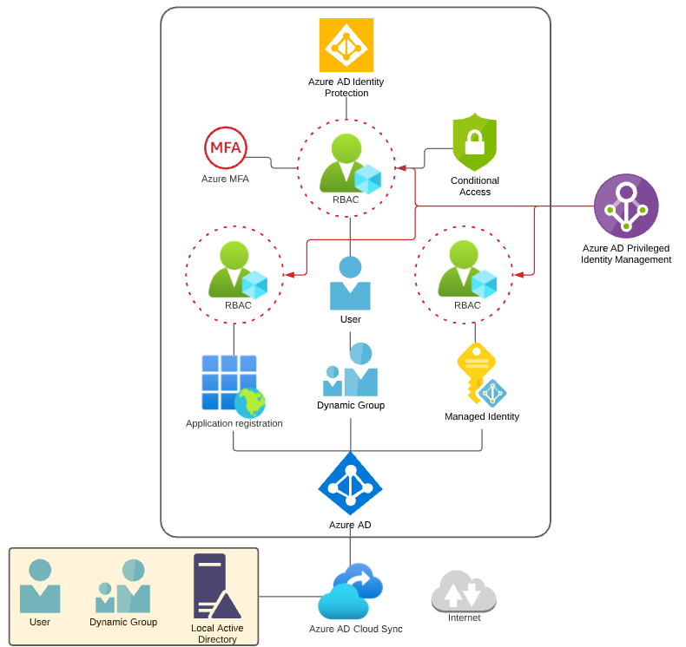
Identity and Access Scenario

Slide 4

Tenant vs. Subscription

Slide 5

Hybrid Identity

Slide 6

Azure Management Scopes
/ Tenant Root

Slide 7
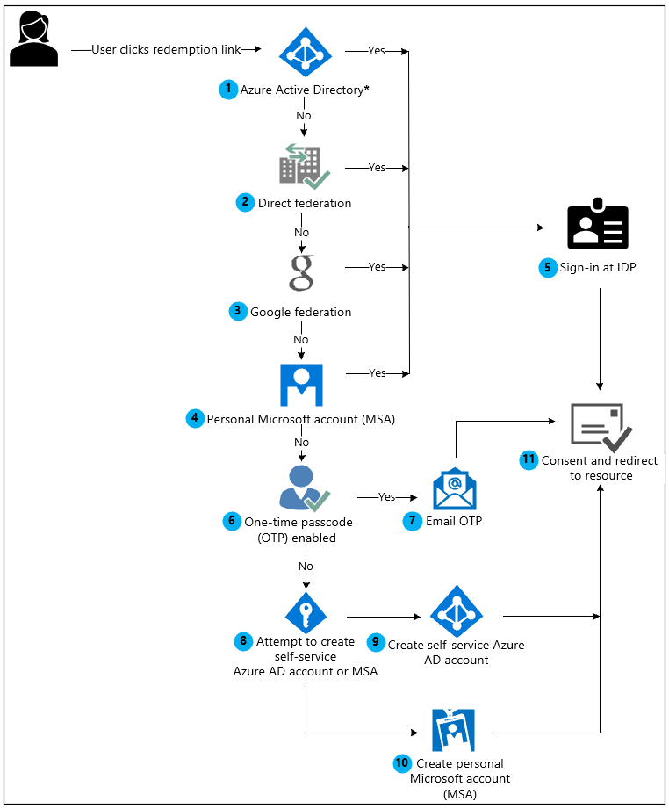
Azure AD B2B Collaboration

Slide 8
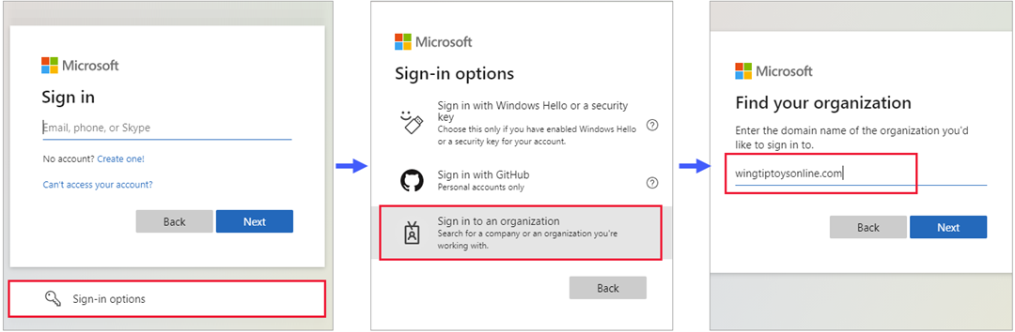
Azure AD B2B Collaboration

Slide 9
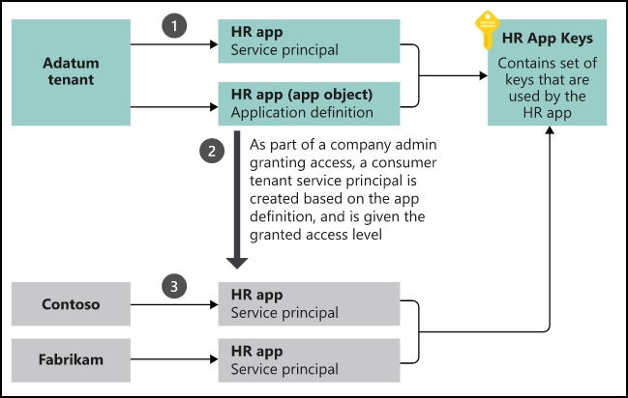
App Registrations & Service Principals

Slide 10


Azure AD B2C

Slide 11

Azure AD Domain Services

Slide 12
Azure AD Connect

Slide 13

Passthrough Authentication

Slide 14

ADFS Federation

Slide 15
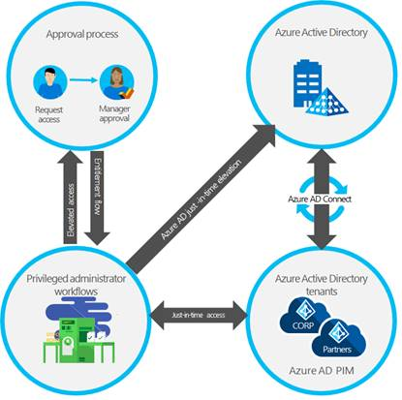
Azure AD PIM

Slide 16
Implement Platform Protection

Slide 17
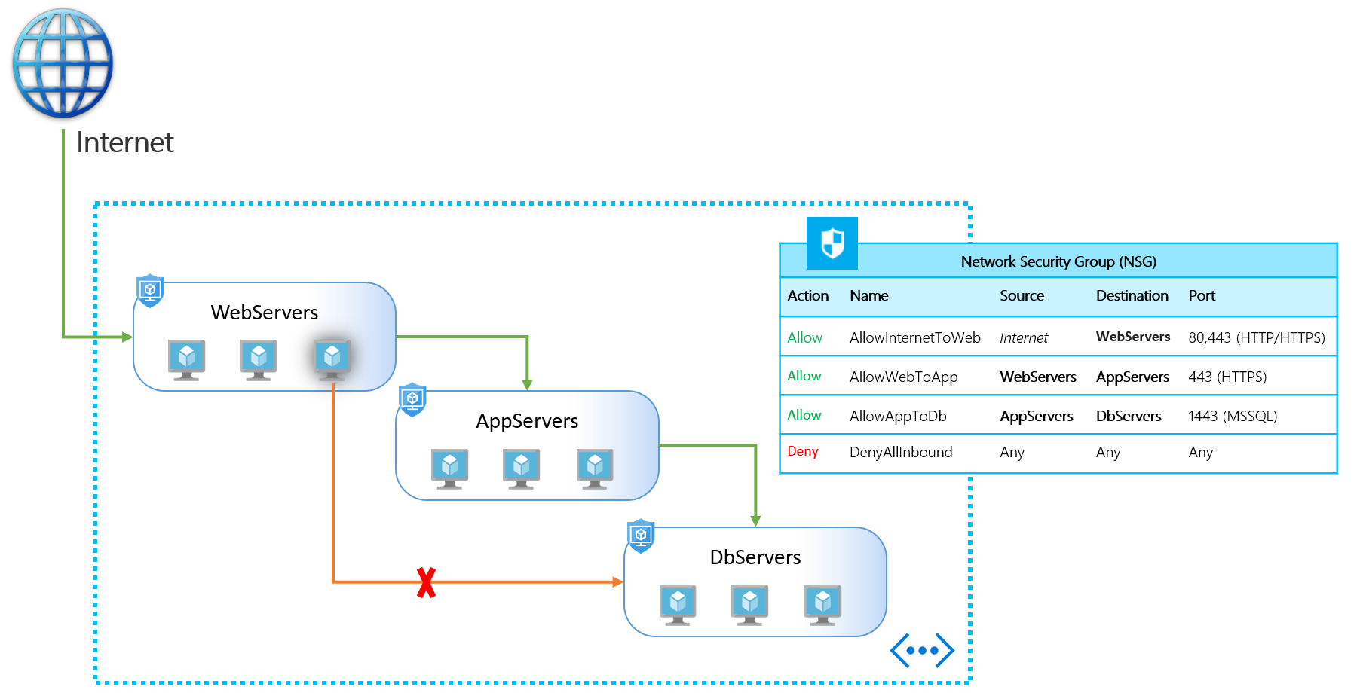
NSGs and ASGs

Slide 18

Multi-Region High Availability

Slide 19

Multi-Region High Availability

Slide 20
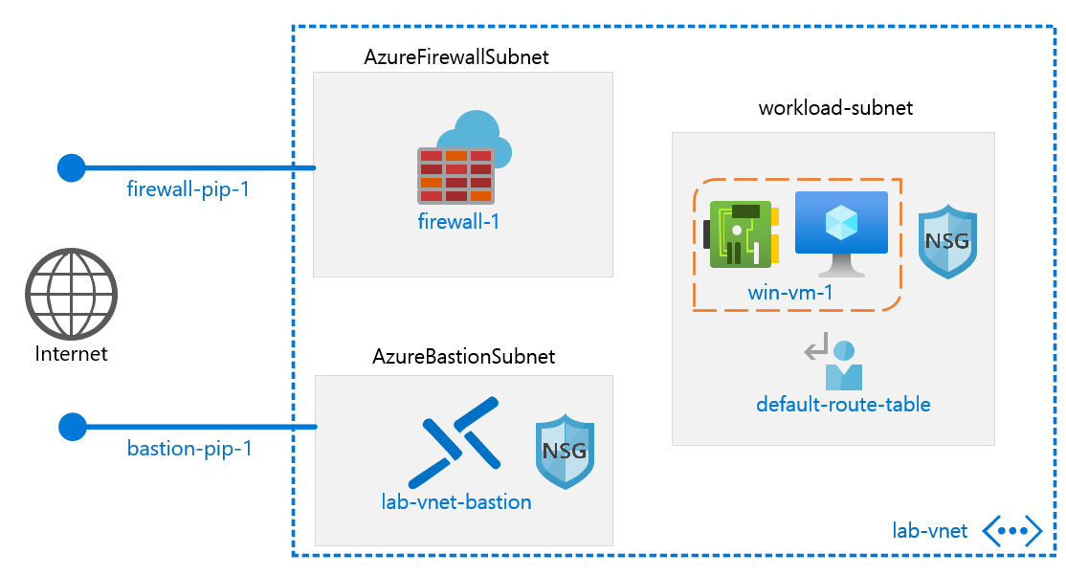
Azure Firewall

Slide 21
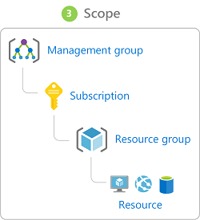
Management Scopes
/ Tenant Root

Slide 22

Service endpoints

Slide 23
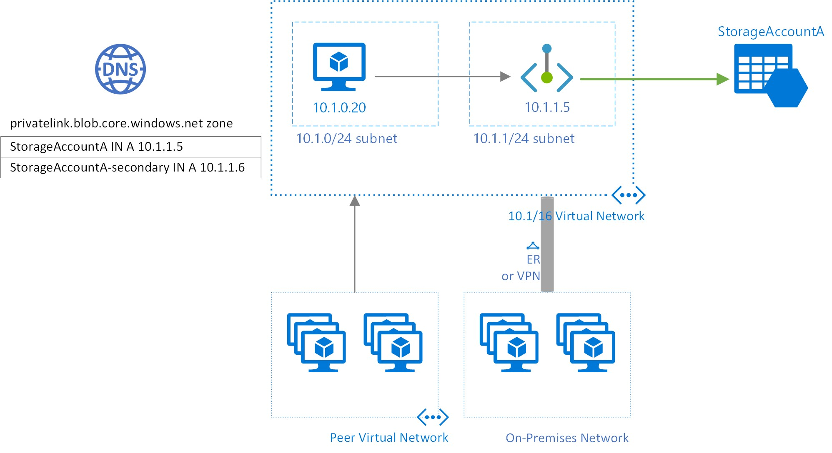
Private endpoints

Slide 24
Compute and Networking

Slide 25
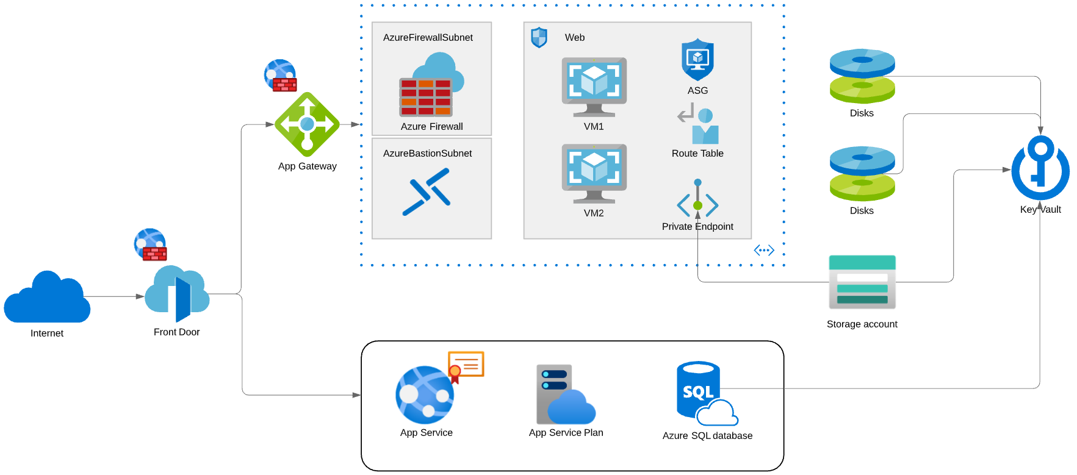
Compute and Networking Scenario

Slide 26
Manage Security Operations

Slide 27
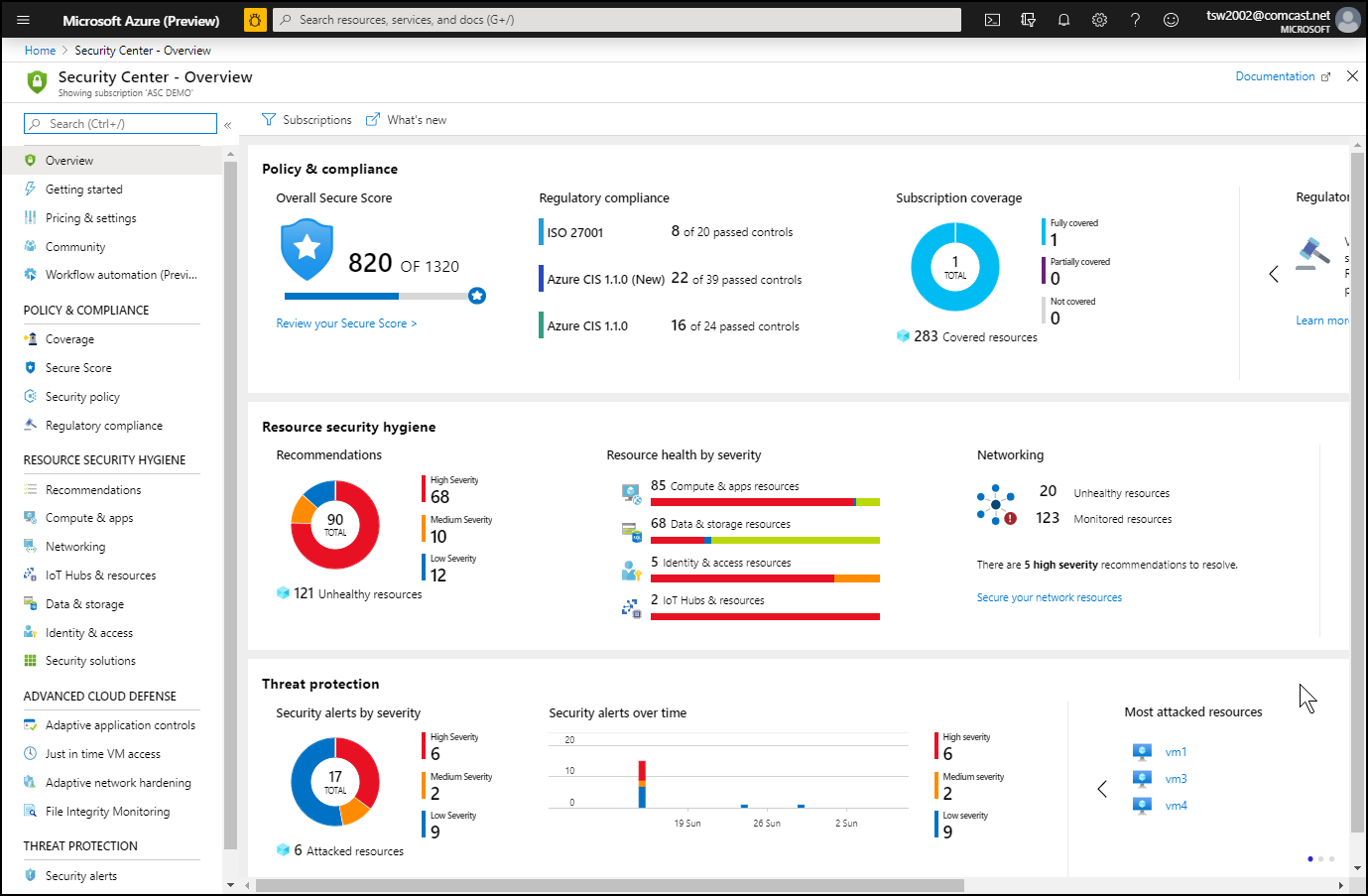
Azure Security Center

Slide 28
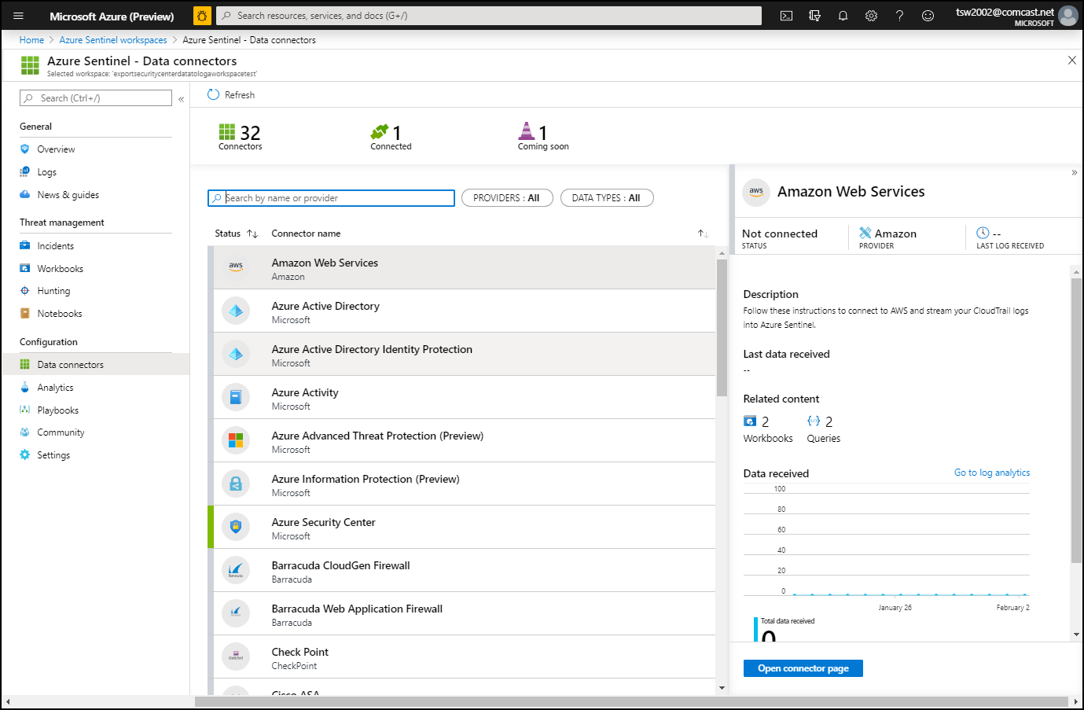
Azure Sentinel

Slide 29
Secure Data and Applications

Slide 30
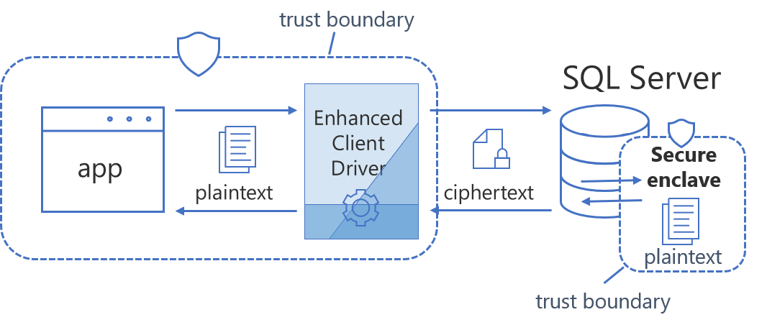
Always Encrypted

Slide 31
Security Operations

Slide 32
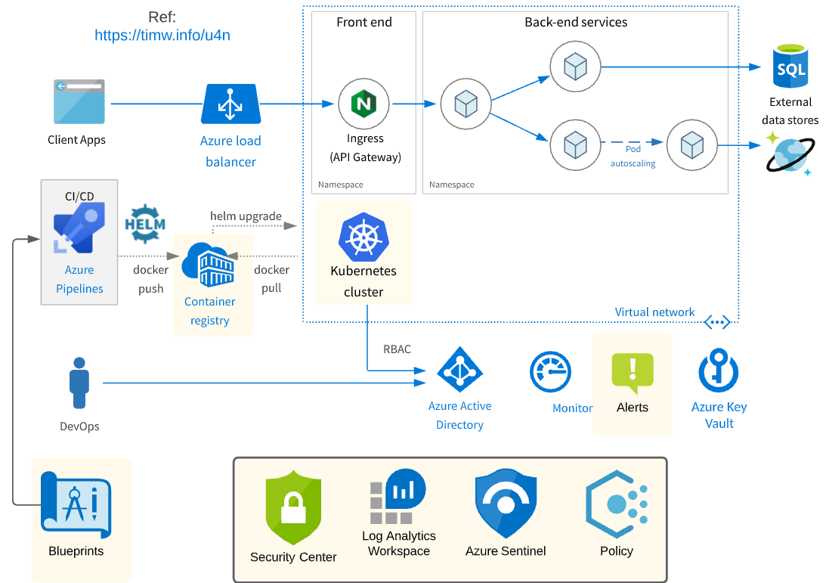
Security Operations Scenario

Slide 33
Exam AZ-500 Item Types

Slide 34

Single Answer Multiple Choice

Slide 35

Multiple Answer Multiple Choice

Slide 36
Repeated Scenario
You need to move an Azure VM to another hardware host.
Solution: You redeploy the VM.
Does this solution meet the goal?
Yes
No

Slide 37
Repeated Scenario
You need to move an Azure VM to another hardware host.
Solution: You enable boot diagnostics.
Does this solution meet the goal?
Yes
No

Slide 38

Select and Place

Slide 39

Build List and Reorder

Slide 40

Active Screen

Slide 41

Case Study

Slide 42






Performance-Based Testing

Slide 43
Microsoft Online Testing

Slide 44
Microsoft Online Testing Process
timw.info/online

Slide 45

Microsoft Online Testing Process

Slide 46

Microsoft Online Testing Process

Slide 47

Microsoft Online Testing Process

Slide 48

Microsoft Online Testing Process

Slide 49

Microsoft Online Testing Process

Slide 50

Microsoft Online Testing Process

Slide 51

Microsoft Online Testing Process

Slide 52
AZ-500 Exam Strategy
Focus your skills accordingly:
60 percent Azure portal
20 percent Azure PowerShell
10 percent Azure CLI
10 percent KQL
Azure AD PIM all day long
Expect performance-based labs, but be happy if you don't see 'em

Slide 53
Parting Advice
Check out my YouTube (timw.info)
Online testing
Cert item strategy
AZ-500 study guide
Invest in Whizlabs or MeasureUp
Register for your exam ASAP!

Slide 54
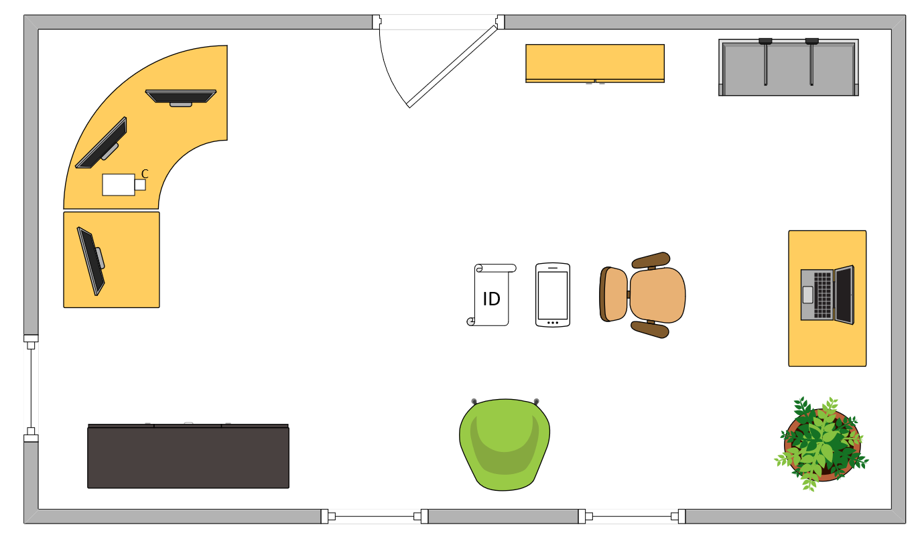

Tim’s Ideal Testing Room
No interruptions or bio breaks
Cover monitors and cameras
Pull back for environment photos
Clear table with laptop

Slide 55
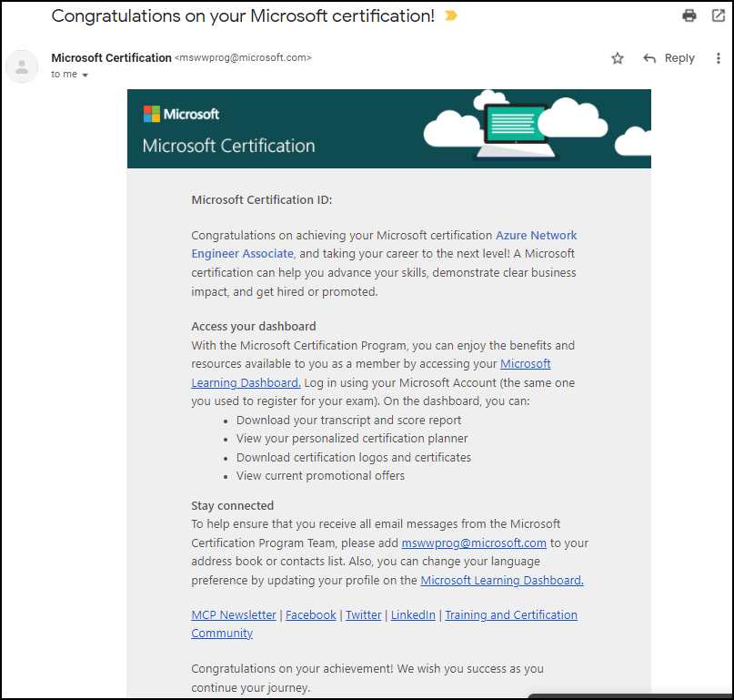
Congratulations!

Slide 56
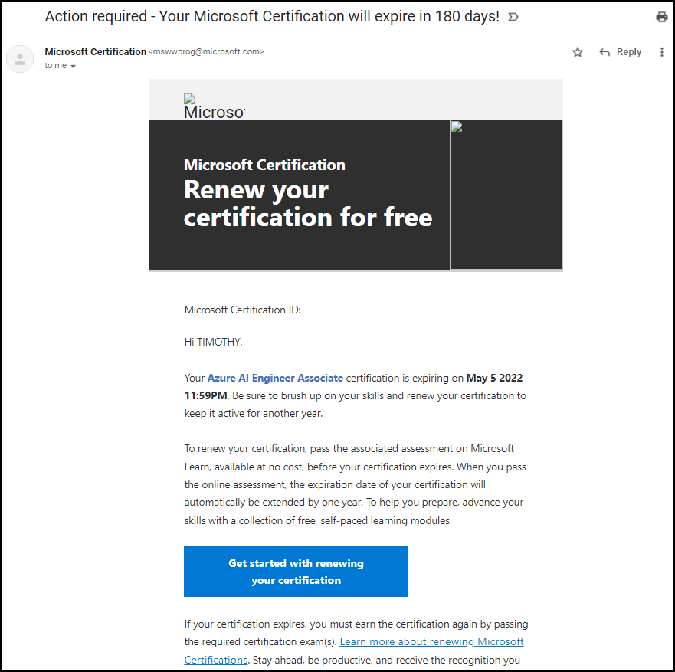
Certification Renewal

